Slide 1
Insights on ride- hailing data
Khalida Nihal

Slide 2
Summary of tools used
The Following analysis has been done using Python and Power BI. Python was used for data cleansing, data preparation(creating derived columns) and formatting needs. I have used it as it provides statistical information and insights on data in a gist using various libraries.
This cleaned data was used as input to power BI for creating charts/graphs. Power BI was chosen as it allows to create interactive visualization and explore data dynamically. The charts/graphs make it easy to filter data, to find outliers and aggregate data as per analysis needs. It enables to create any derived or calculated columns to make better sense of the data.

Slide 3
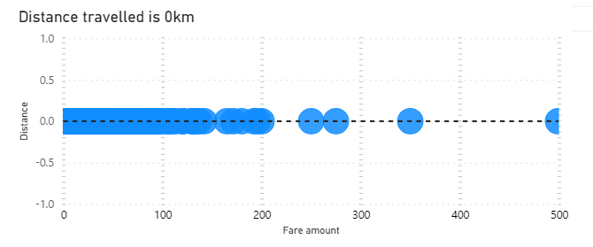
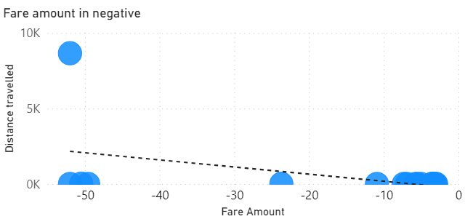
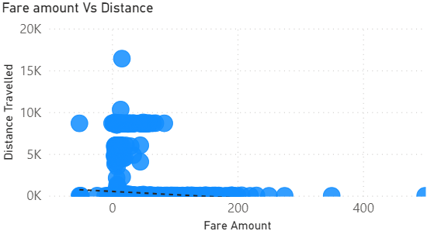
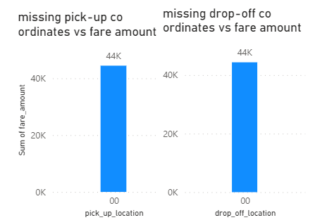
The data discrepancies found
Fare amount in negative
The fare amount is negative for a few trips with passengers. Need to check with business to get context if there is a possibility of data being negative due to application of discounts, cancellation or reimbursement or use of promotions or vouchers?
Trips with 0km and high fare amounts.
Trips with large distance and minimum or “0’ fare amounts.
Need to discuss with business to understand the possibility of scenarios where this occurs. Would these be covered in free or cancelled trips or promotions and how do we recognize such data?
Missing pick-up and drop –off co ordinates that sums up to 44000$approx in revenue
The complete data would help in assessing the accurate & popular pick up and drop off location.

Slide 4
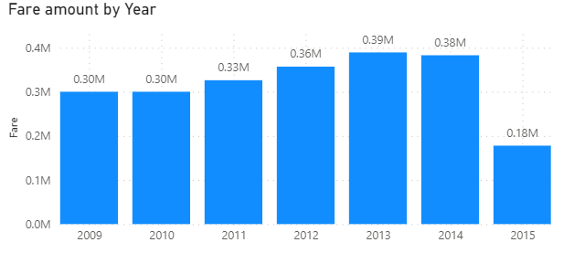
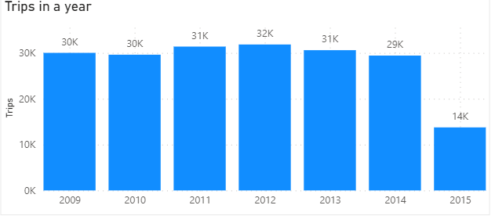
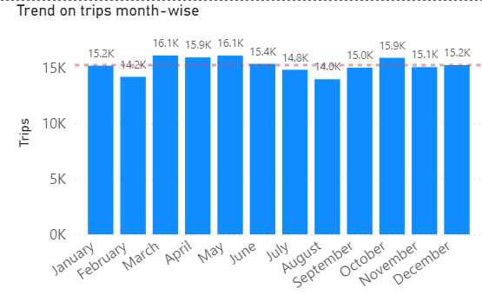
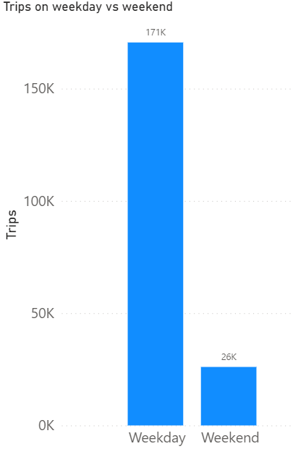
Yearly, monthly and weekly insights
WEEKDAYS HAVE GREATER NUMBER OF TRIPSTHAN WEEKENDS
General trend in revenue is consistently improving
March, April, May and October perform better than other months
This information can be used for promotions on weekends to increase trips.
It is also useful to target different areas over the weekends to gain more trips than usual.
We can see fare amounts(revenue) and trips are consistently increasing year over year except 2014 which seemed to be a bit stagnant.
Please note that year 2015, though has a low number doesn’t signify a fall in business. This year has only 6 months of data which is displayed here.
Without taking 2015 into account, all the other years show the trend of better performance in these months.
These months can be leveraged for achieving more trips in target locations.

Slide 5
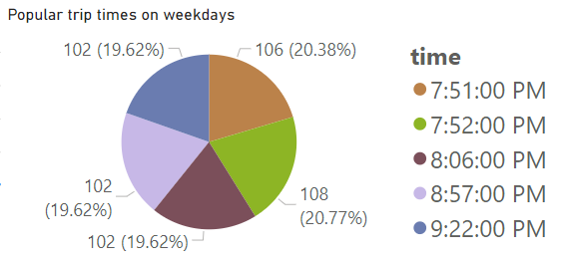
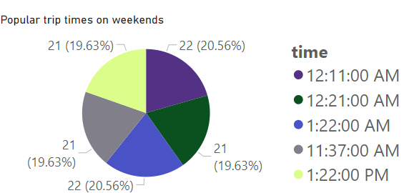
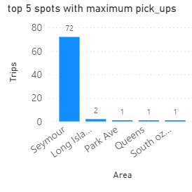
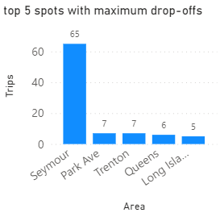
Popular trip times and location
TOP 5 Popular PICK-UP AND DROP AREAS.
This information can be utilized when expanding the business and using target areas to get good number of trips.
Deploying more drivers or vehicles in these areas will ensure trips are achieved as they are busy areas.
TOP 5 Popular trip times ON WEEKDAYS AND WEEKENDS.
This information can help in optimizing the driver allocation, pricing strategies and ensuring service availability.
This can also be used to ensure drivers are available at this time and accept trip request.

Slide 6
Additional datasets required to enhance analysis
Drop off time can help in calculating the time taken for each ride. This will help in comparing trips with same routes and deducing high and low traffic times which in turn can be used for dispatching more or a smaller number of vehicles in a given area.
Driver details, to be cognizant of how many trips each driver is taking and can help with optimizing the efficiency of drivers.
Customer information can help with behaviour analysis such as frequent destinations, common routes, or preferred time for travel. This information can help to create custom ads for them as well.

Slide 7
Action Items
To resolve data discrepancies with business to get a better understanding of the operations. To get enough context on issues to be able to ignore them as junk data or work upon them.
As weekdays have more number of trips than weekends, we can discuss with business to come up with strategies to increase number of trips in the weekends.
Optimizing Driver allocation,pricing strategies and ensuring service availability by leveraging the information on busy hours of the day.
Business can expand its operations by utilizing the information on areas which are in demand for taking trips(pick up location)
Work on getting the additional datasets to provide better insights that can help business.

Slide 8
THANK YOU
Khalida Nihal
khalidanihal@gmail.com

